Slide 1


DSA0613-Data Handing and Visualization for Data Analysis
Social Media Impact Analysis Through Data Visualization
Supervisor
Dr. Kumaragurubaran T,
Dr. Senthilvadivu S
Department of Computer Science and Engineering,
Saveetha School Of Engineering
Presented by:
K.R.Lohithya (192424154)
Y.Raga Pranavi(192424219)
Department of AIDS
Saveetha School of Engineering

Slide 2
Introduction
Social media creates large amounts of user interaction data.
Engagement data includes likes, comments, and shares.
Data visualization turns this data into simple charts and graphs.
It helps understand trends and user behavior.

Slide 3
Objectives
To collect social media engagement data.
To analyze likes, comments, and shares.
To visualize data using charts and graphs.
To identify trends and user behavior patterns.
To support better decision-making using insights.

Slide 4
Literature Review / Background
Integrating social media data from multiple platforms enables comprehensive and consistent analysis of user engagement.
Reference: Smith, J. & Kumar, R. (2023). Cross-Platform Social Media Data Integration for Analytics.
Visual analysis techniques help identify engagement patterns and trends that are difficult to detect using raw data.
Reference: Chen, M. et al. (2022). Visual Analytics for Social Media Data.
Well-designed charts and dashboards enhance user understanding and support effective decision-making.
Reference: Almasi, S. et al. (2023). Usability Evaluation of Dashboards.
Automated visualization and reporting systems improve efficiency by delivering timely and actionable insights.
Reference: Soni, P. (2024). Automatic Dashboard Recommendation Systems.

Slide 5
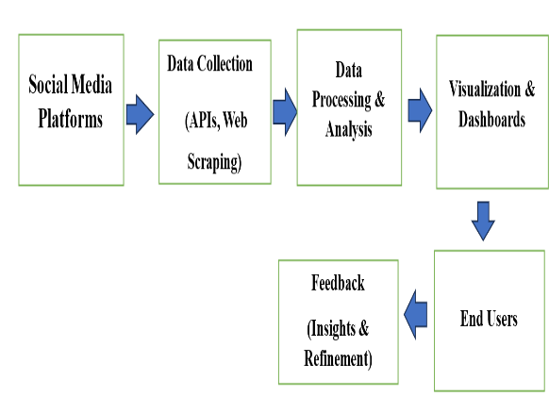
System Design / Architecture

Slide 6
Module 1: Engagement Amount & Proportion Analysis
Collect engagement data (likes, comments, shares, reach).
Clean and organize the data before analysis.
Calculate total engagement per post or platform.
Use bar charts and histograms for visualization.
Compare engagement across posts and platforms.

Slide 7
Outcomes for Module-1
Shows total engagement and its distribution across posts/platforms.
Identifies proportion of likes, comments, and shares.
Enables easy comparison of engagement performance.
Highlights high-performing content and dominant engagement types.
Improves understanding of audience interaction patterns.

Slide 8
Module 2: Relationship & Trend Analysis
Use date-wise engagement data.
Analyze relationship between engagement metrics.
Track how engagement changes over time.
Identify increasing or decreasing trends.
Compare trends across platforms.
Show trends using charts.

Slide 9
Outcomes for Module-2
Identifies engagement trends over time.
Shows relationships between likes, comments, and shares.
Highlights growth or decline patterns.
Helps compare trends across platforms or posts.
Supports better prediction and planning decisions.
Improves understanding of user behavior changes.

Slide 10
Methodology
Collect social media data such as likes, comments, and shares.
Store the data in a structured dataset with dates and platforms.
Clean and prepare the data for analysis.
Calculate total engagement values.
Perform Engagement Amount & Proportion Analysis (Module 1).
Perform Relationship & Trend Analysis (Module 2).
Create bar charts and visual dashboards.
Interpret results and generate insights.

Slide 11
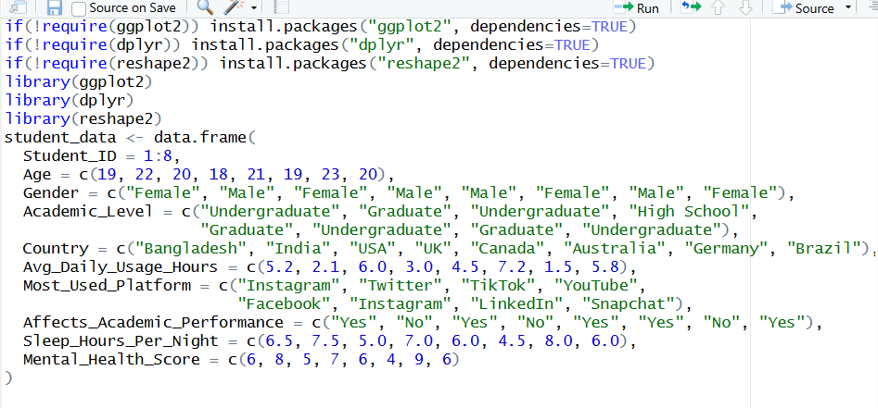
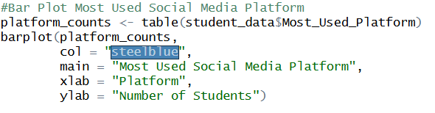
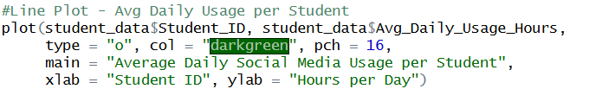
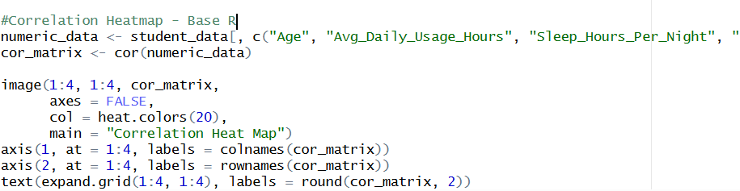
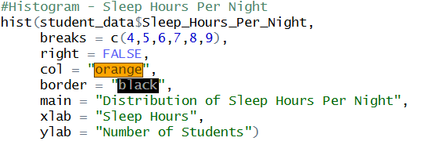
Implementation

Slide 12
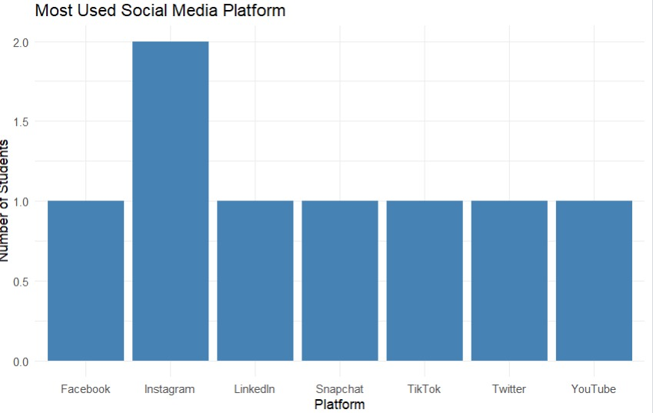
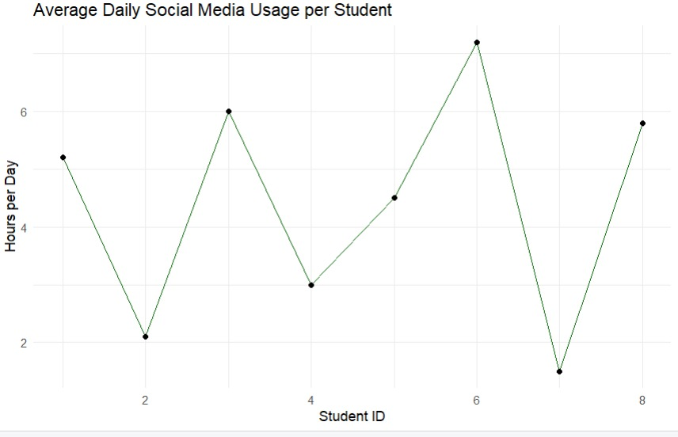
output

Slide 13
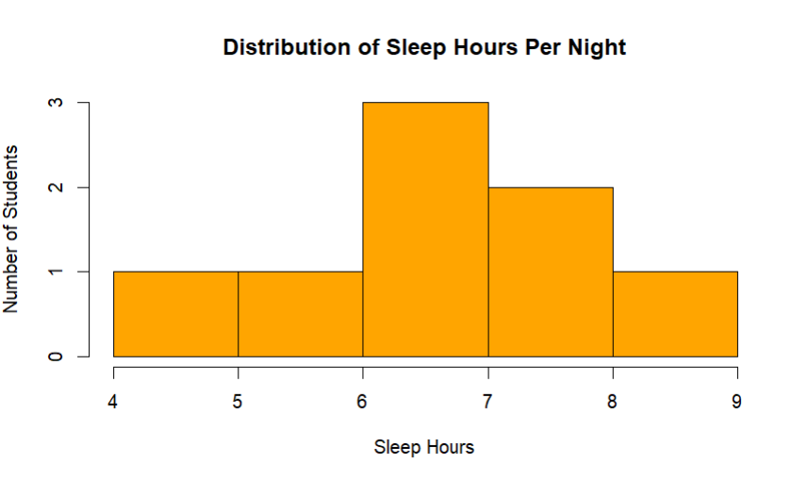
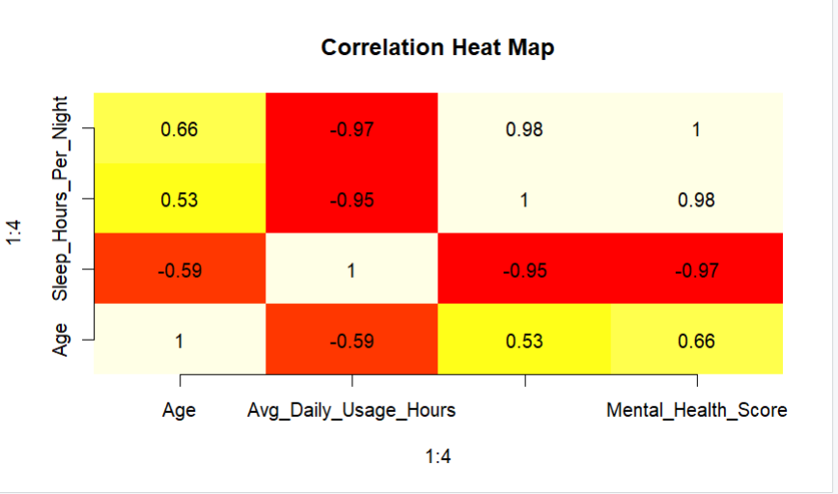
Output

Slide 14
Results & Discussion
The results show that data visualization clearly explains social media engagement patterns.
Module 1 identifies total engagement levels and the proportion of likes, comments, and shares.
Module 2 reveals relationships between engagement metrics and trends over time. Overall, visualization helps in understanding user behavior and improving social media strategies.

Slide 15
Future Scope
Include real-time data collection using social media APIs for live analysis.
Analyze multiple platforms (Instagram, Facebook, Twitter, YouTube) together.
Add advanced analytics such as sentiment analysis and user demographics.
Use machine learning to predict future engagement trends.
Develop interactive dashboards with filters and drill-down features.

Slide 16
Challenges & Limitations
Small dataset may not represent real-world behavior
Manually created data can contain bias or errors
Limited variables reduce depth of analysis
Correlation does not imply causation
Not suitable for large or real-time datasets

Slide 17
Conclusion
Data visualization helps understand the impact of social media on students’ habits and well-being.
Visuals reveal hidden patterns and trends that are hard to see in raw data.
This analysis supports informed decisions and better awareness.
Results can be improved by using larger, real-world datasets.

Slide 18
References
Romero, C., Ventura, S., & García, E. (2024). Learning analytics and educational data mining: Trends, challenges, and opportunities. Wiley Interdisciplinary Reviews: Data Mining and Knowledge Discovery, 14(2), e1492.
Knaflic, C. N. (2024). Storytelling with Data: Let’s Practice! Wiley.
OECD. (2024). Education at a Glance 2024: OECD Indicators. Organisation for Economic Co-operation and Development.
Pew Research Center. (2024). Social Media Use and Its Impact on Mental Health Among Students. Pew Research Center.
UNESCO. (2025). Global Education Monitoring Report 2025: Technology, Data, and Learning Outcomes. United Nations Educational, Scientific and Cultural Organization.

Slide 19
THANKYOU !!

